Slide 1

OPTIMIZING CALL CENTER OPERATIONS: A DATA-DRIVEN APPROACH
RAMYA KRISHNAN A
ramyakrishnana2001@gmail.com

Slide 2
INTRODUCTION:
In today's fast-paced business environment, call centers play a crucial role in customer service and sales. However, efficiently managing call center operations can be challenging due to factors such as fluctuating call volumes, agent performance, and resource allocation. In this project, we leverage data-driven techniques to optimize call center operations and improve overall efficiency.

Slide 3
PROBLEM STATEMENT:
Call centers face several challenges impacting their efficiency and effectiveness. These include managing fluctuating call volumes influenced by seasonality and campaigns, which can lead to longer wait times and reduced customer satisfaction. Optimizing lead conversion involves identifying engagement factors and refining follow-up strategies. Enhancing agent productivity requires monitoring metrics like call handling time and resolution rates, adjusting staffing and training accordingly. Resource allocation poses another challenge, balancing agent capacity, technology needs, and infrastructure costs to meet SLAs efficiently. Addressing these challenges is crucial for maintaining high service standards while managing operational costs effectively in dynamic environments.

Slide 4
DATA IMPORT AND PREPROCESSING:
Importing Excel file into Jupyter Notebook
Data cleaning process, including removal of null values and handling of missing data

Slide 5

DATA VISUALIZATION USING TABLEAU:

Slide 6
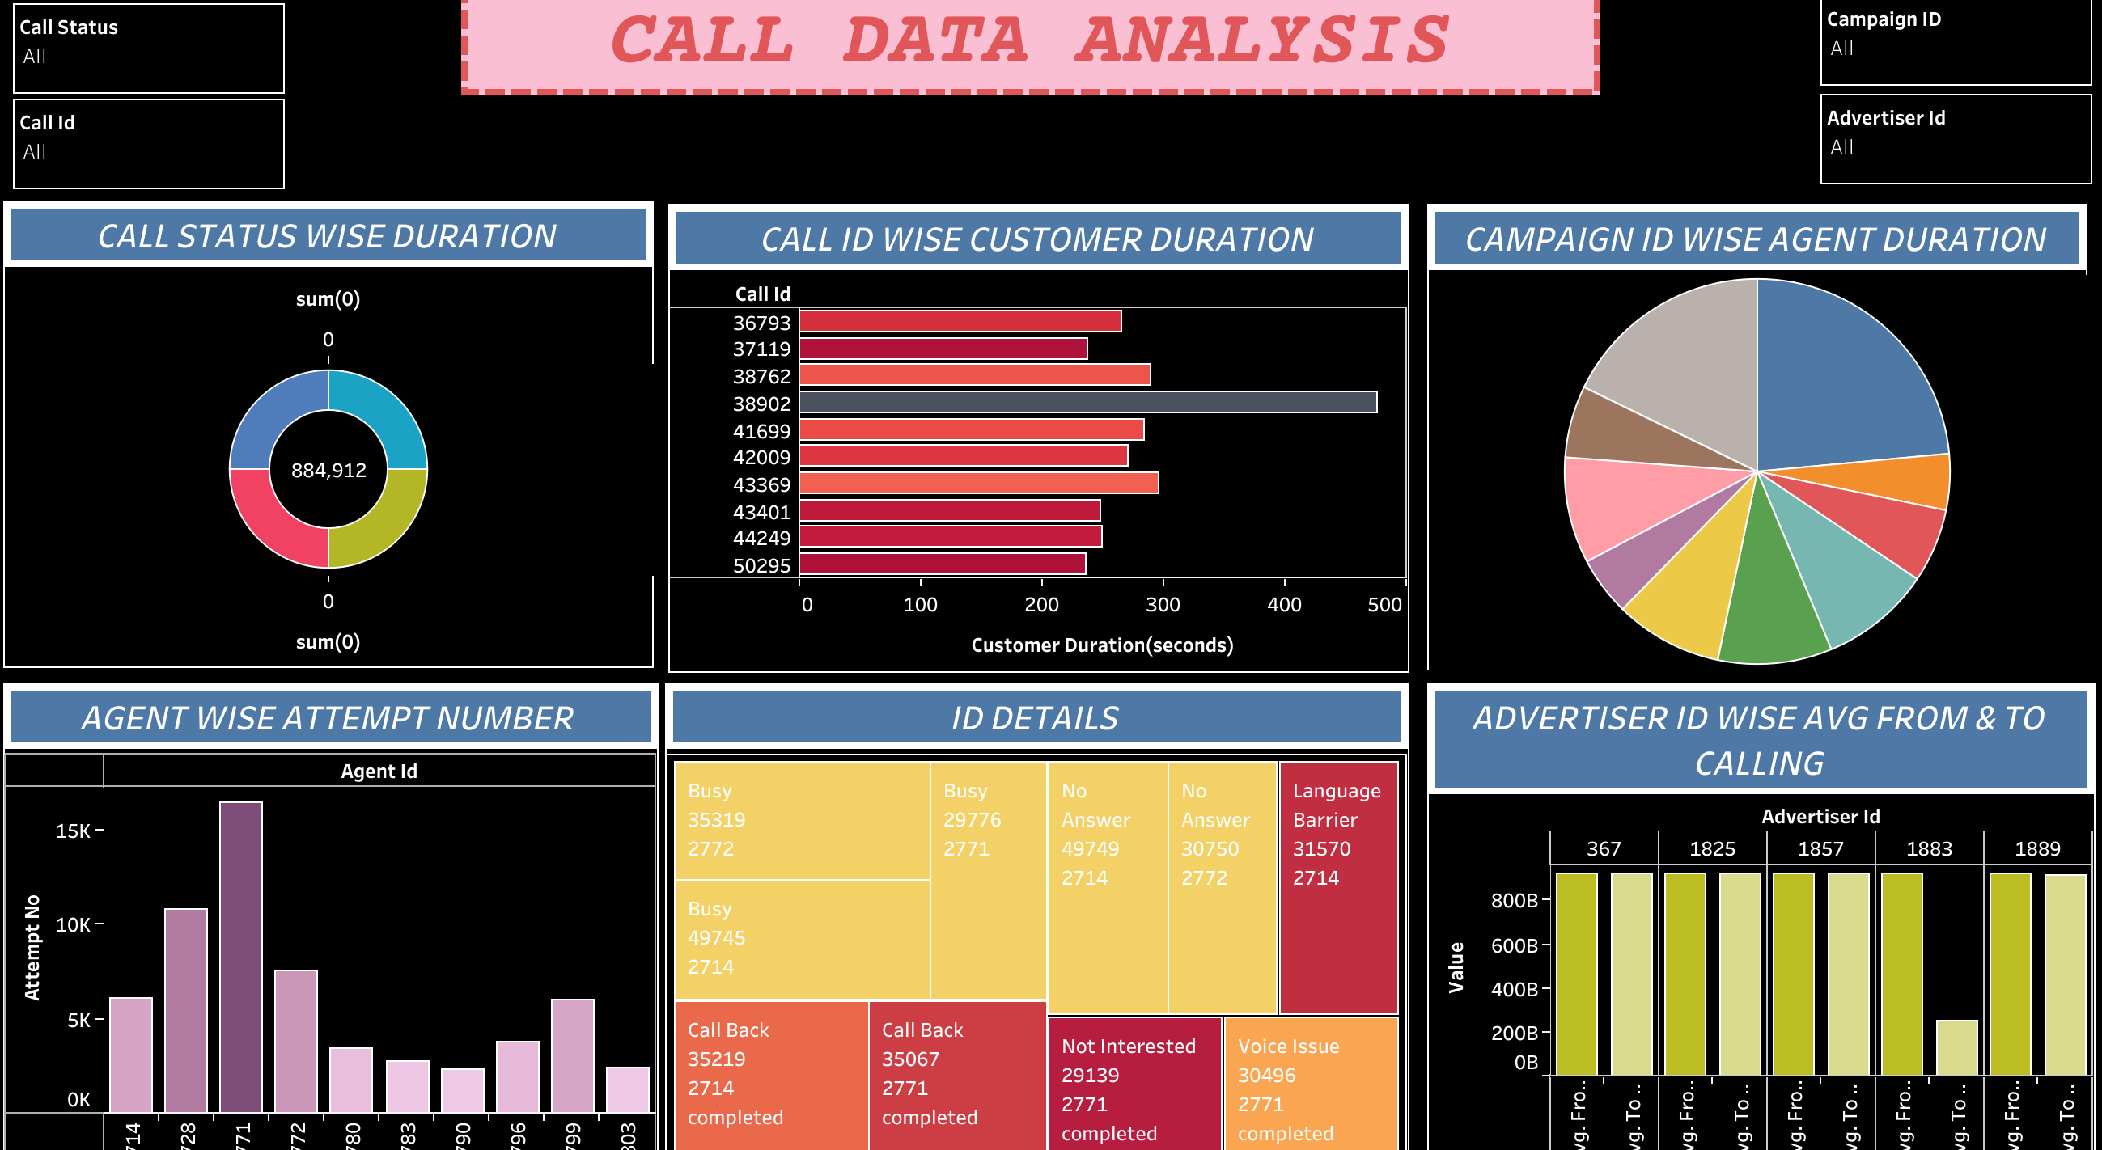

Slide 7
BAR CHART FOR AGENT WISE ATTEMPT NUMBER:
Visualizes the distribution of attempts made by each agent.
Allows comparison of attempt numbers across different agents.
Enables identification of top-performing agents based on the number of attempts.

Slide 8
DONUT CHART FOR CALL STATUS WISE DURATION:
Represents the distribution of call durations based on call status.
Inner circle displays agent duration (seconds) for each call status.
Outer circle displays customer duration (seconds) for each call status.
Provides insights into the duration of calls based on their status.

Slide 9
TREE MAP FOR ID DETAILS:
Utilizes a hierarchical structure to visualize ID details, including call status, lead status, and attempt number.
Each rectangle within the tree map represents a specific ID, with the size proportional to the associated metric (e.g., duration).
Enables easy identification of patterns and outliers in ID-related metrics.

Slide 10
CALL BAR CHART FOR ID WISE CUSTOMER DURATION:
Illustrates the customer duration (seconds) for each call ID.
Provides a visual representation of call durations, allowing comparison across different call IDs.
Facilitates identification of calls with unusually long or short durations.

Slide 11
PIE CHART FOR CAMPAIGN ID WISE AGENT DURATION:
Displays the distribution of agent duration (seconds) across different campaign IDs.
Each segment of the pie chart represents a campaign ID, with the size proportional to the total agent duration.
Offers insights into the distribution of agent effort across different campaigns.

Slide 12
SIDE-BY-SIDE BARS FOR ADVERTISER ID WISE FROM AND TO CALLING:
Compares the frequency of calls made from and to different advertiser IDs.
Each advertiser ID is represented by a pair of bars, one for calls made from the advertiser and the other for calls made to the advertiser.
Facilitates analysis of calling patterns and interactions with advertisers.

Slide 13
CONCLUSION
In summary, this project has offered data-driven insights and solutions to address challenges in call center management. By analyzing historical data, forecasting call volumes, optimizing lead conversion, enhancing agent productivity, and allocating resources efficiently, we've outlined strategies for improving overall performance and customer satisfaction. Through data-driven decision-making, call centers can enhance efficiency, meet service level agreements, and ultimately improve the customer experience.

Slide 14


